Slide 1
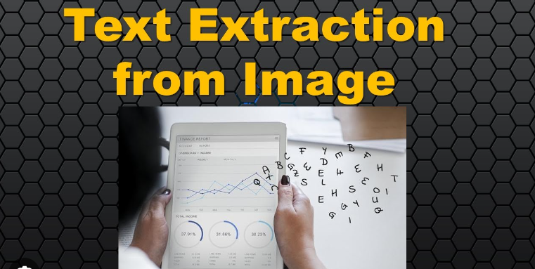
Extracting text from Images
Rahul Wakalkar

Slide 2
Dataset:
There are 16 Images in jpg format
Urjayant Engineering Pvt. Ltd-1.jpg,
Vasav Precision Engg. Pvt. Ltd-1.jpg,
Nirmala Precision Tools-1.jpg,
Okay Tools Pvt. Ltd-1.jpg,
Permali Wallace Pvt Ltd-1.jpg,
Pravin Traders-1.jpg,
Rajhans Fabrication Pvt. Ltd-1.jpg,
Recherche Industries-1.jpg,
Shakuntech Packing Pvt. Ltd-1.jpg,Shiv Om Fastners-1.jpg,
Shubhada Polymers Products P.Ltd-1.jpg,
Sterling Fabory (India) Pvt. Ltd-1.jpg,
Supernova Waterjet Cutting Systems-1.jpg,
Tanmay Engineering-1.jpg,
Trimbakeshwar Engineering Pvt. Ltd-1.jpg

Slide 3
Introduction:
Data extraction: Text extraction can be used to extract data from images, such as the text on a
product label or the text in a scanned document. This data can then be used for a variety of
purposes, such as product tracking, customer analytics
Information retrieval: Text extraction can be used to improve the search ability of images. By extracting
the text from an image, it can be indexed and searched along with other text documents. This makes
it easier to find images that are relevant to a particular query.
Accessibility: Text extraction can be used to make images more accessible to people with visual
impairments. By Extracting the text from an image, it can be converted into a format that can be read
by a screen reader.
Application:
OCR software
E-commerce
Social media
Medical imaging

Slide 4
Process:
Acquire the image
Pre-process the image
Detect the text regions
Recognize the text
Pytesseract is a Python wrapper for the Tesseract OCR engine. It allows you to extract text from images
and PDFs using Python. Pytesseract is a free and open-source library.

Slide 5
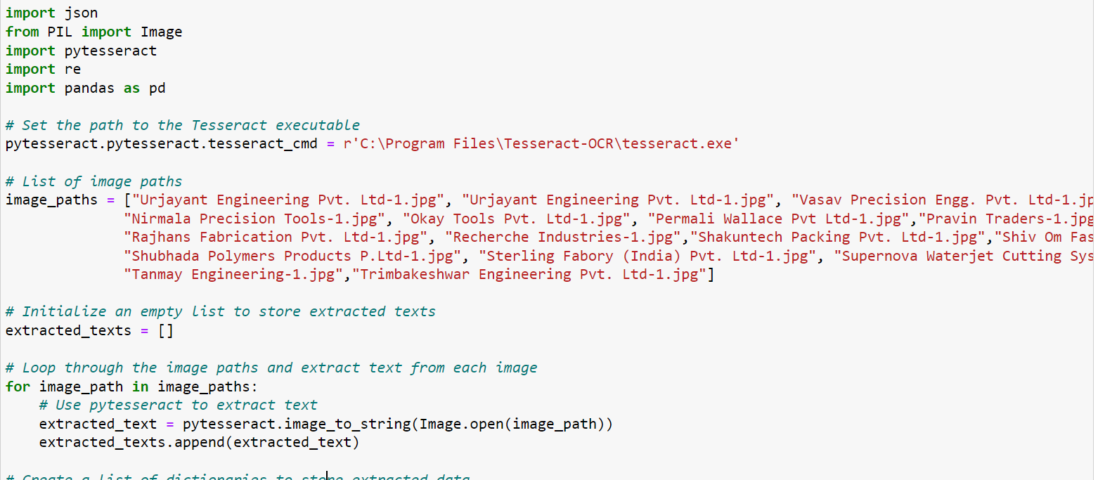

Slide 6
Advantages of text Extraction:
Efficiency
Accuracy
Scalability
Cost-effectiveness
Accessibility
Data Mining
Compliance

Slide 7
Use cases:
OCR software
E-commerce
Social media
Medical imaging
Legal professionals
Finance
Customer service
Compliance
Research
Data mining

Slide 8
Challenges:
Noisy data
Variation in fonts, styles, and layouts
Ambiguity
Language
Quality of the image

Slide 9
Techniques for Improved Results:
Provide tips for improving text extraction accuracy:
Image preprocessing (resizing, enhancing contrast)
Choosing appropriate OCR settings
Handling multi-language text

Slide 10
Inaccuracies in complex layouts
Difficulties in extracting structured data
Limited context understanding
Limitations

Slide 11
Future Trends:
The future of text extraction is bright. As the technology continues to improve, text extraction is
likely to become more accurate, reliable, and efficient.
Deep learning
Multimodal text extraction
Real-time text extraction
Embedded text extraction
Cross-lingual text extraction

Slide 12
Structured Data

Slide 13
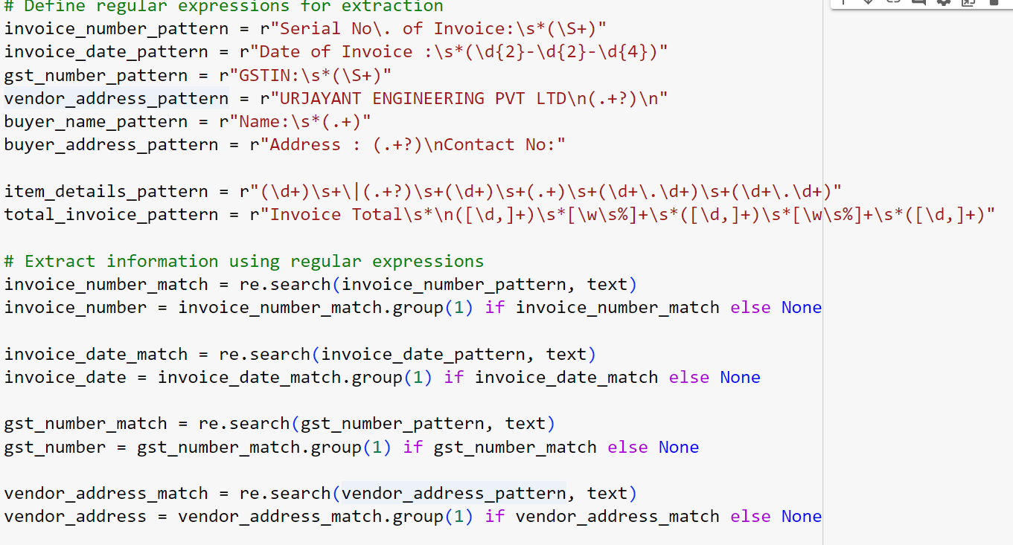

Slide 14
Overview :
Structured data and its significance.
How structured data differs from unstructured data.
Common structured formats (JSON, CSV, XML).

Slide 15
JSON Format
JSON (JavaScript Object Notation) as a popular structured format.
It is key-value pair structure.
Readability and flexibility.

Slide 16
Advantages of JSON:
Advantages of using JSON for storing extracted text:
  Easy to understand and edit
  Suitable for nested and hierarchical data
  Supported by various programming languages

Slide 17
Benefits of Structured Storage:
Benefits of storing extracted text in structured format:
  Easy data retrieval and querying
  Improved data organization and consistency
  Compatibility with data analysis tools

